Slide 1
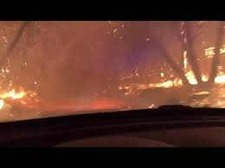
Organizing Firewise Projects/ Actions
Jo Ann Fites-Kaufman, Ph.D.
Retired US Forest Service, Fire Scientist & Land Management Planner

Slide 2
Organizing Firewise Project Actions
Firewise Certification is important – Action to be more Firesafe is end GOAL
Organizing Actions
  What
  Where
  How
  When
  Not necessarily in that order
Continuous Process to reduce fuels – they grow and accumulate

Slide 3
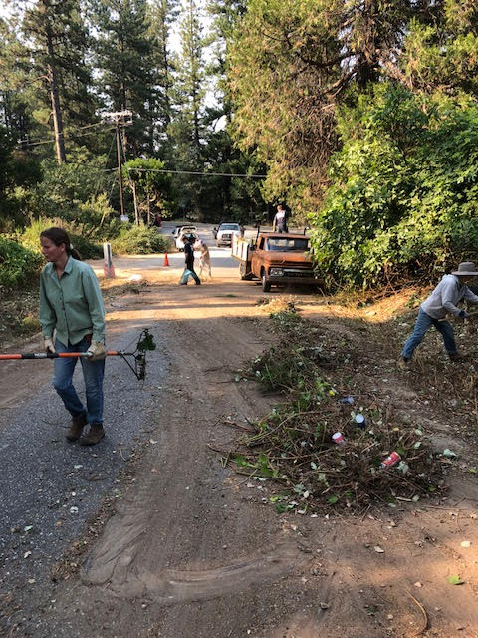
Organizing Actions
Defensible Space, Hardened Structures – following programs
Emphasis here: common evacuation routes
  Where are they?
  What kind of fuel?
  How will it burn?
  What should it look like?
  How to get the work done?
    Private
    County
    Public – NID, BLM, USFS, State

Slide 4
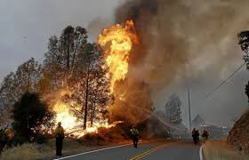
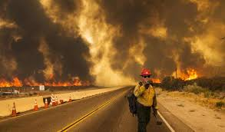
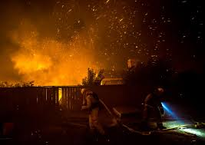
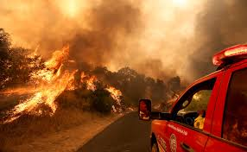
Why are fuels on roads ultra important?
Camp Fire – Sober Lesson
What’s it like to drive when fire is burning around and above?
  Flames over the road
  Smokey, hard to see road
  Embers flying
Speed of fire vs you
  4 to 5 miles in an hour low winds
  1.5 miles in 15 minutes with high winds (20 miles per hour)
  Fire can accelerate suddenly
How do fuels make a difference?
  Less fuels = less flames & heat

Slide 5
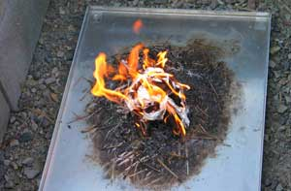
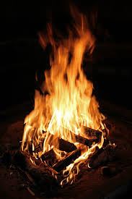
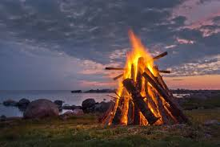
Fire and fuels 101
How hot is that campfire?
Is fire all bad? NO, but not good to drive by hot fire
  Important fuel reduction tool
Our focus today is making communities safer
  See my other presentations if you want to learn more about good fire
How dry is it?
How much is there?

Slide 6
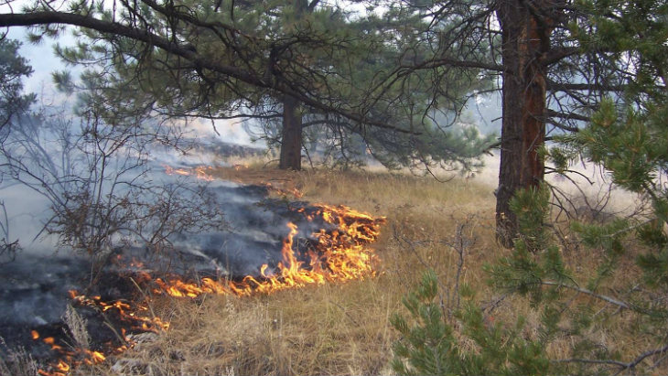
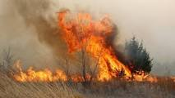
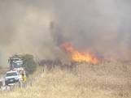
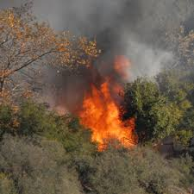
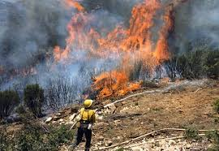
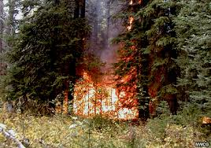
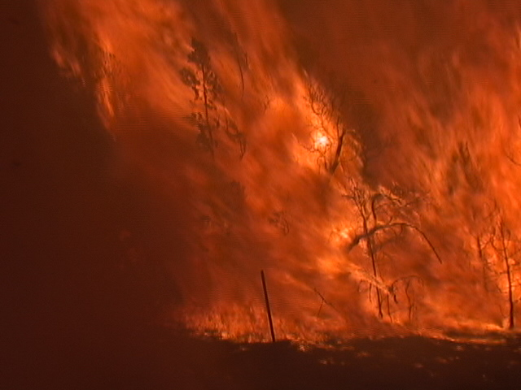
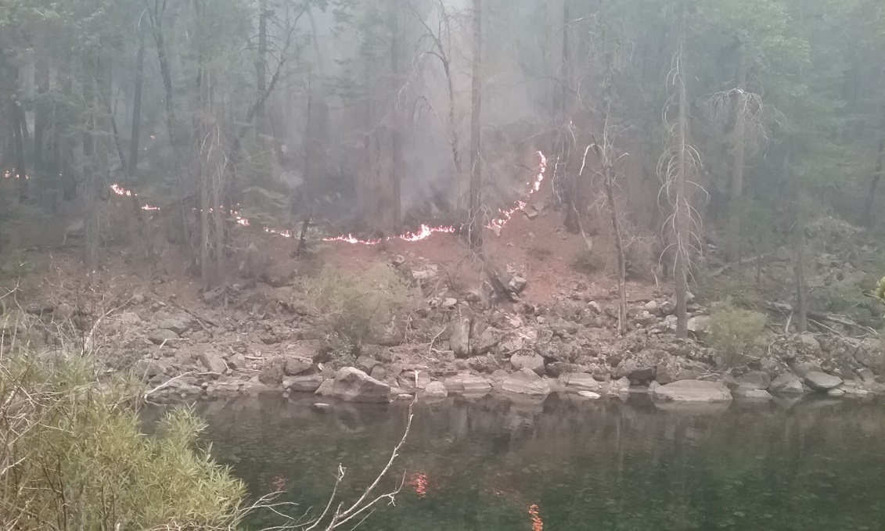
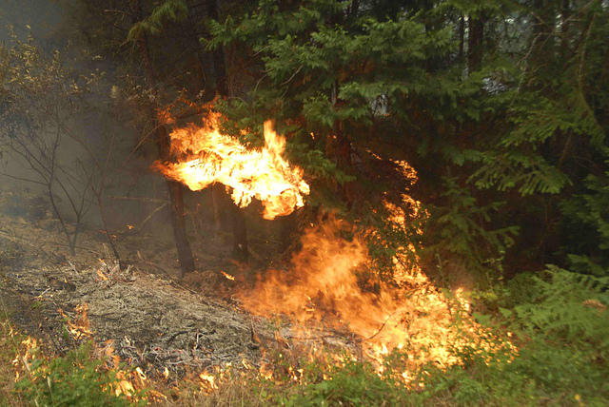
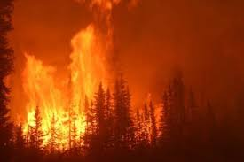
Fire in different vegetation high fire danger (hot, dry or windy)
Grass
Shrubs
& small
trees
Forests

Slide 7
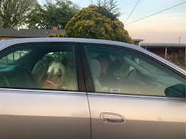
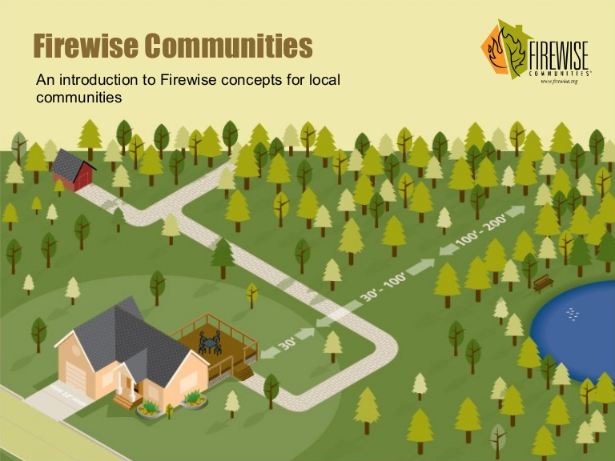
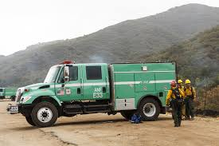
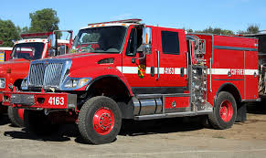
What do safe fuels look like?
Basic CALFIRE requirements
  You need it to get out
  They need safety to come in

Slide 8
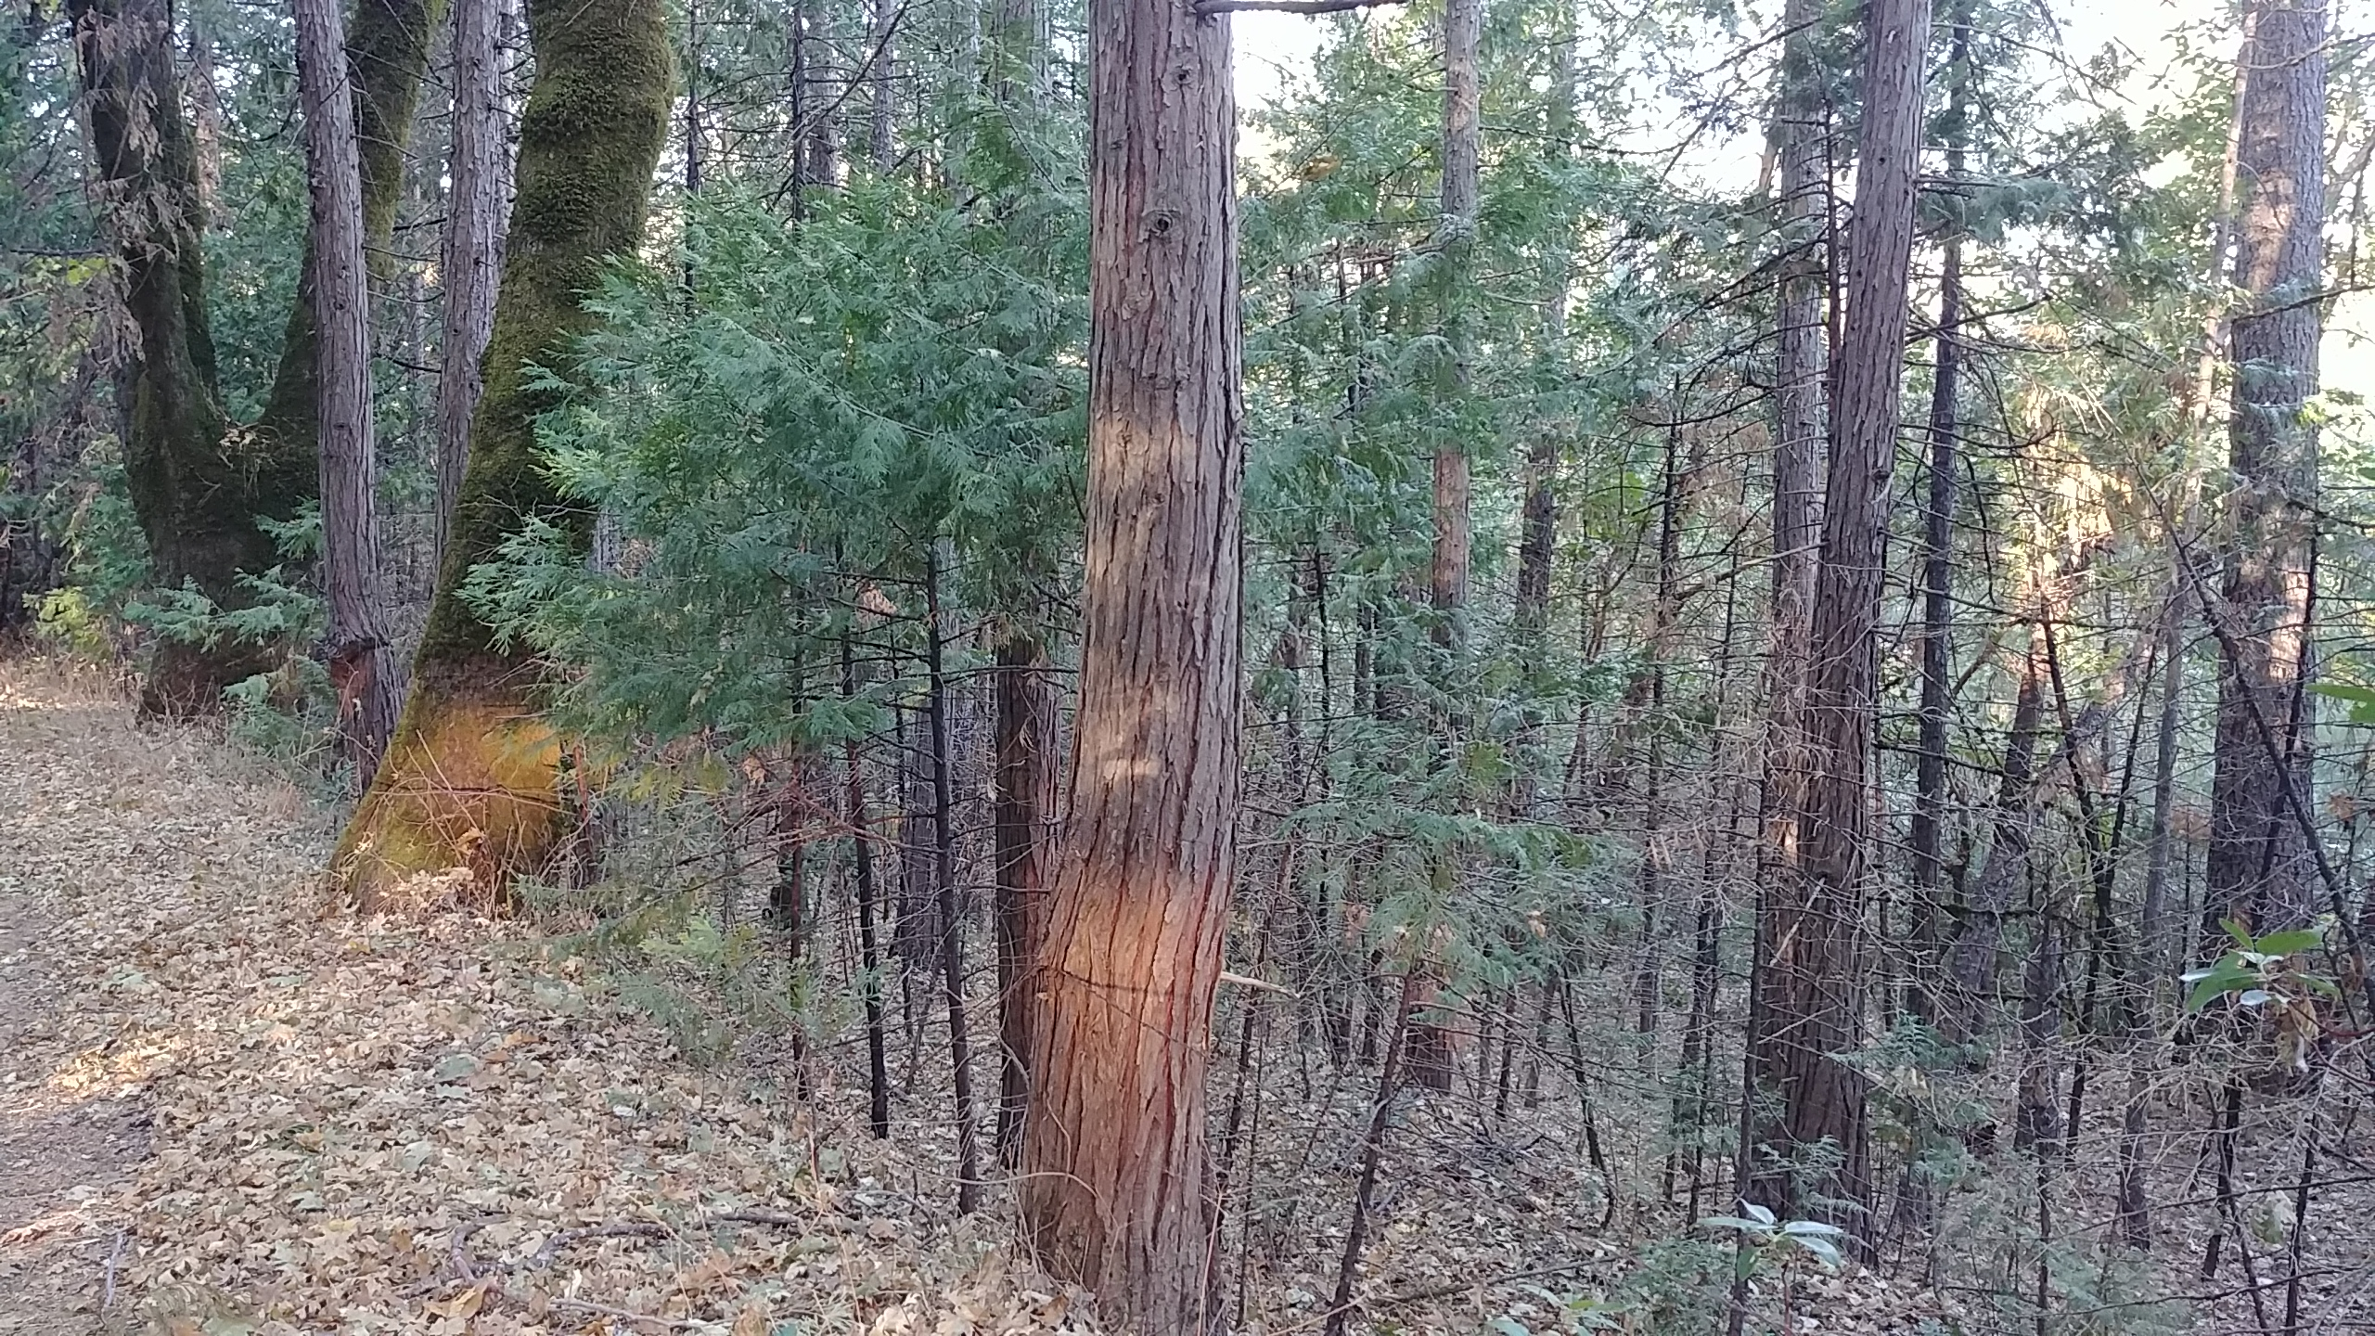
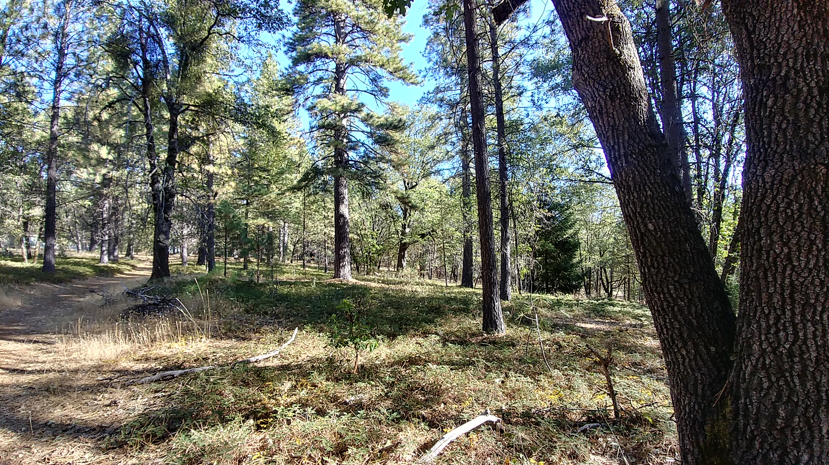
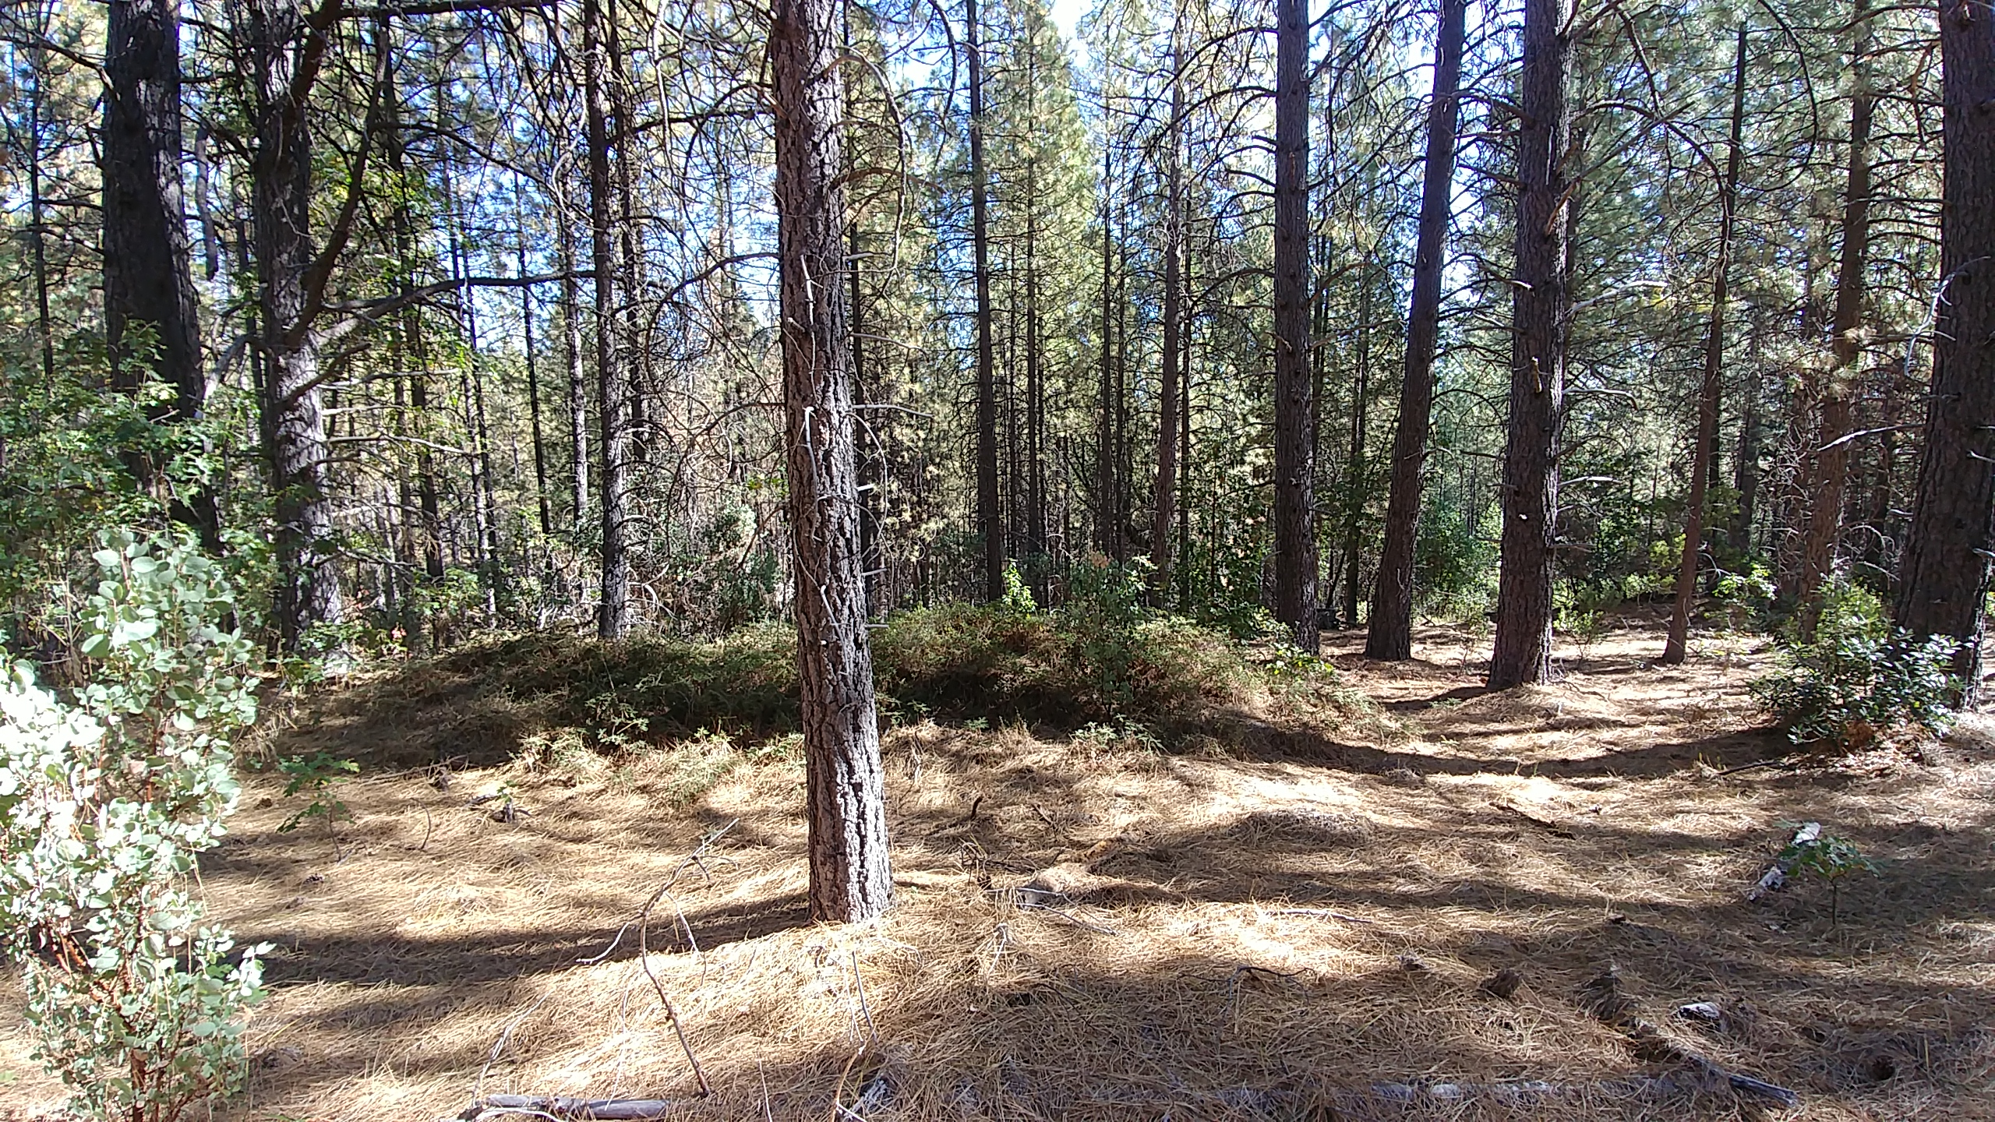
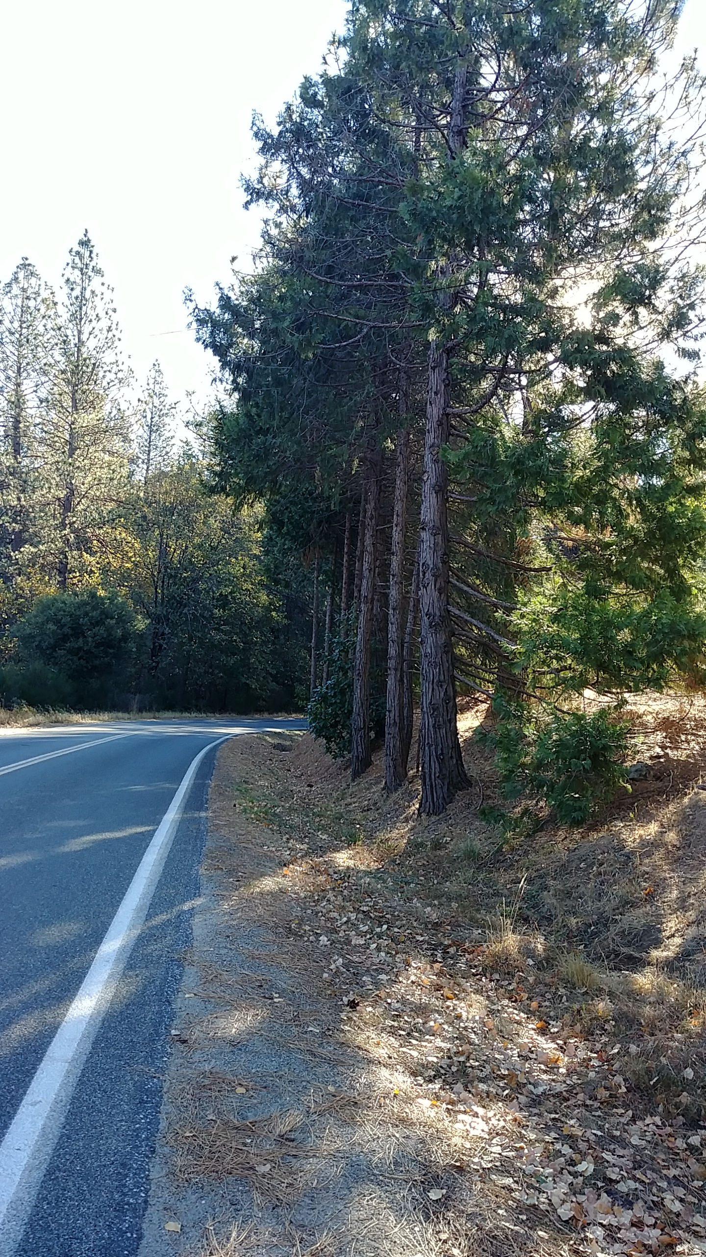
What does it look like? Or not
Trees
Wide spacing, more than 30 feet back
Trees too close
Especially next to
road

Slide 9
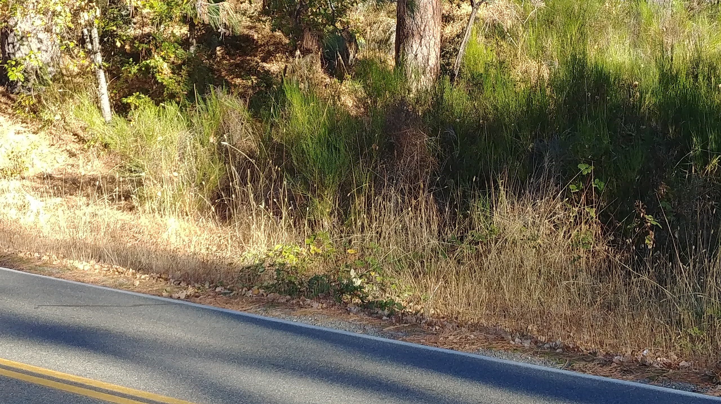
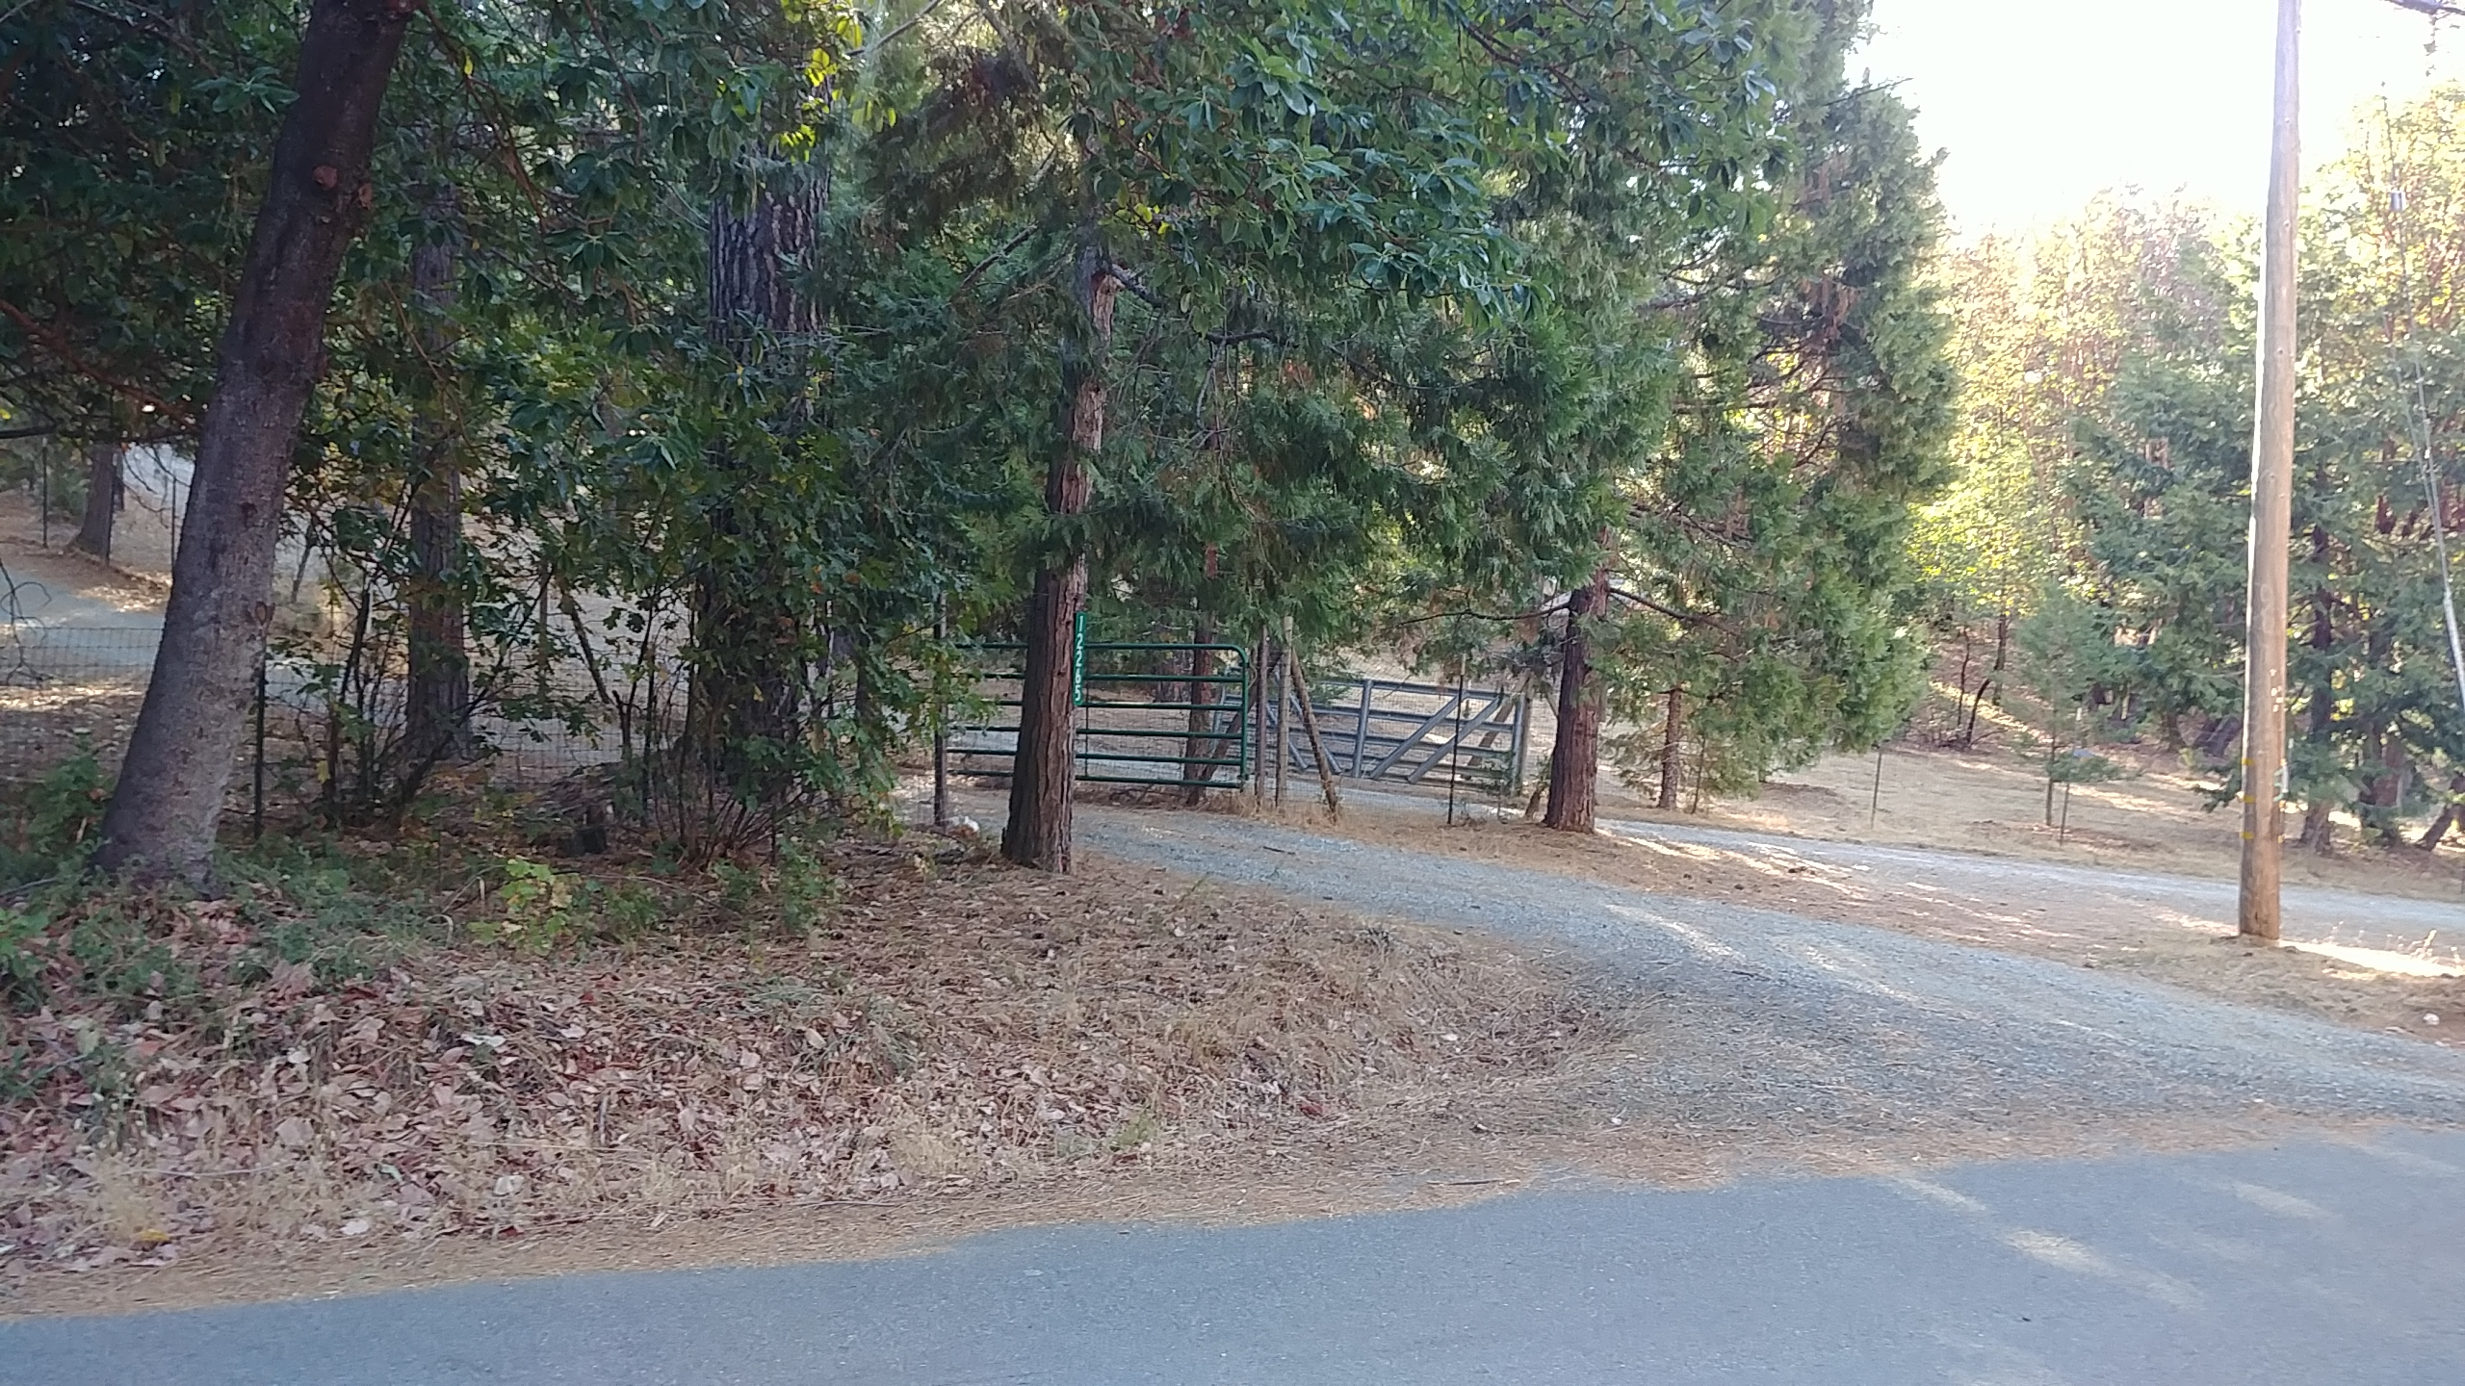
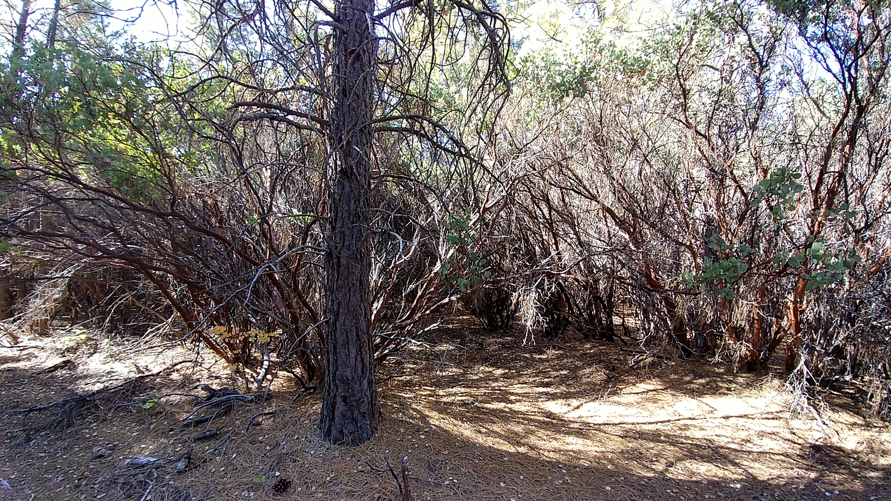
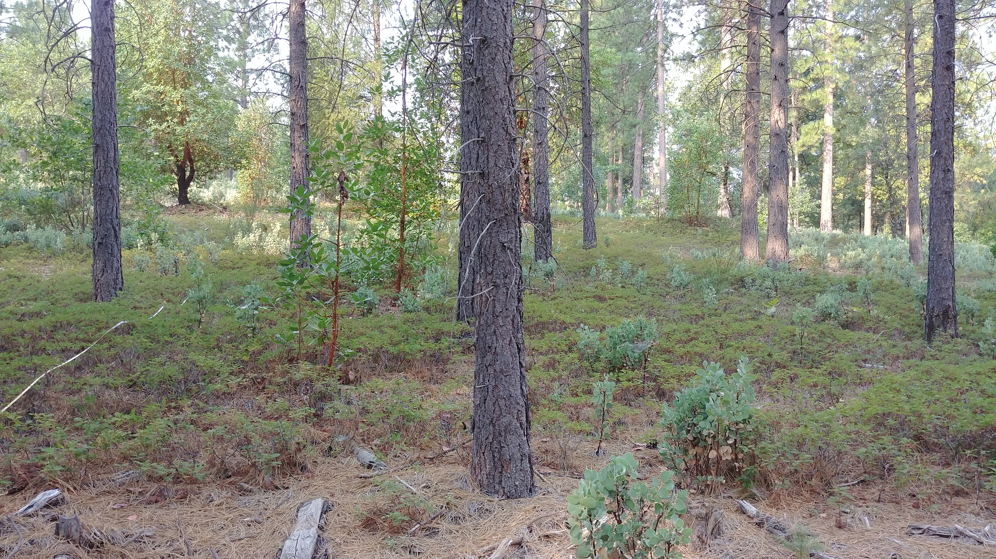
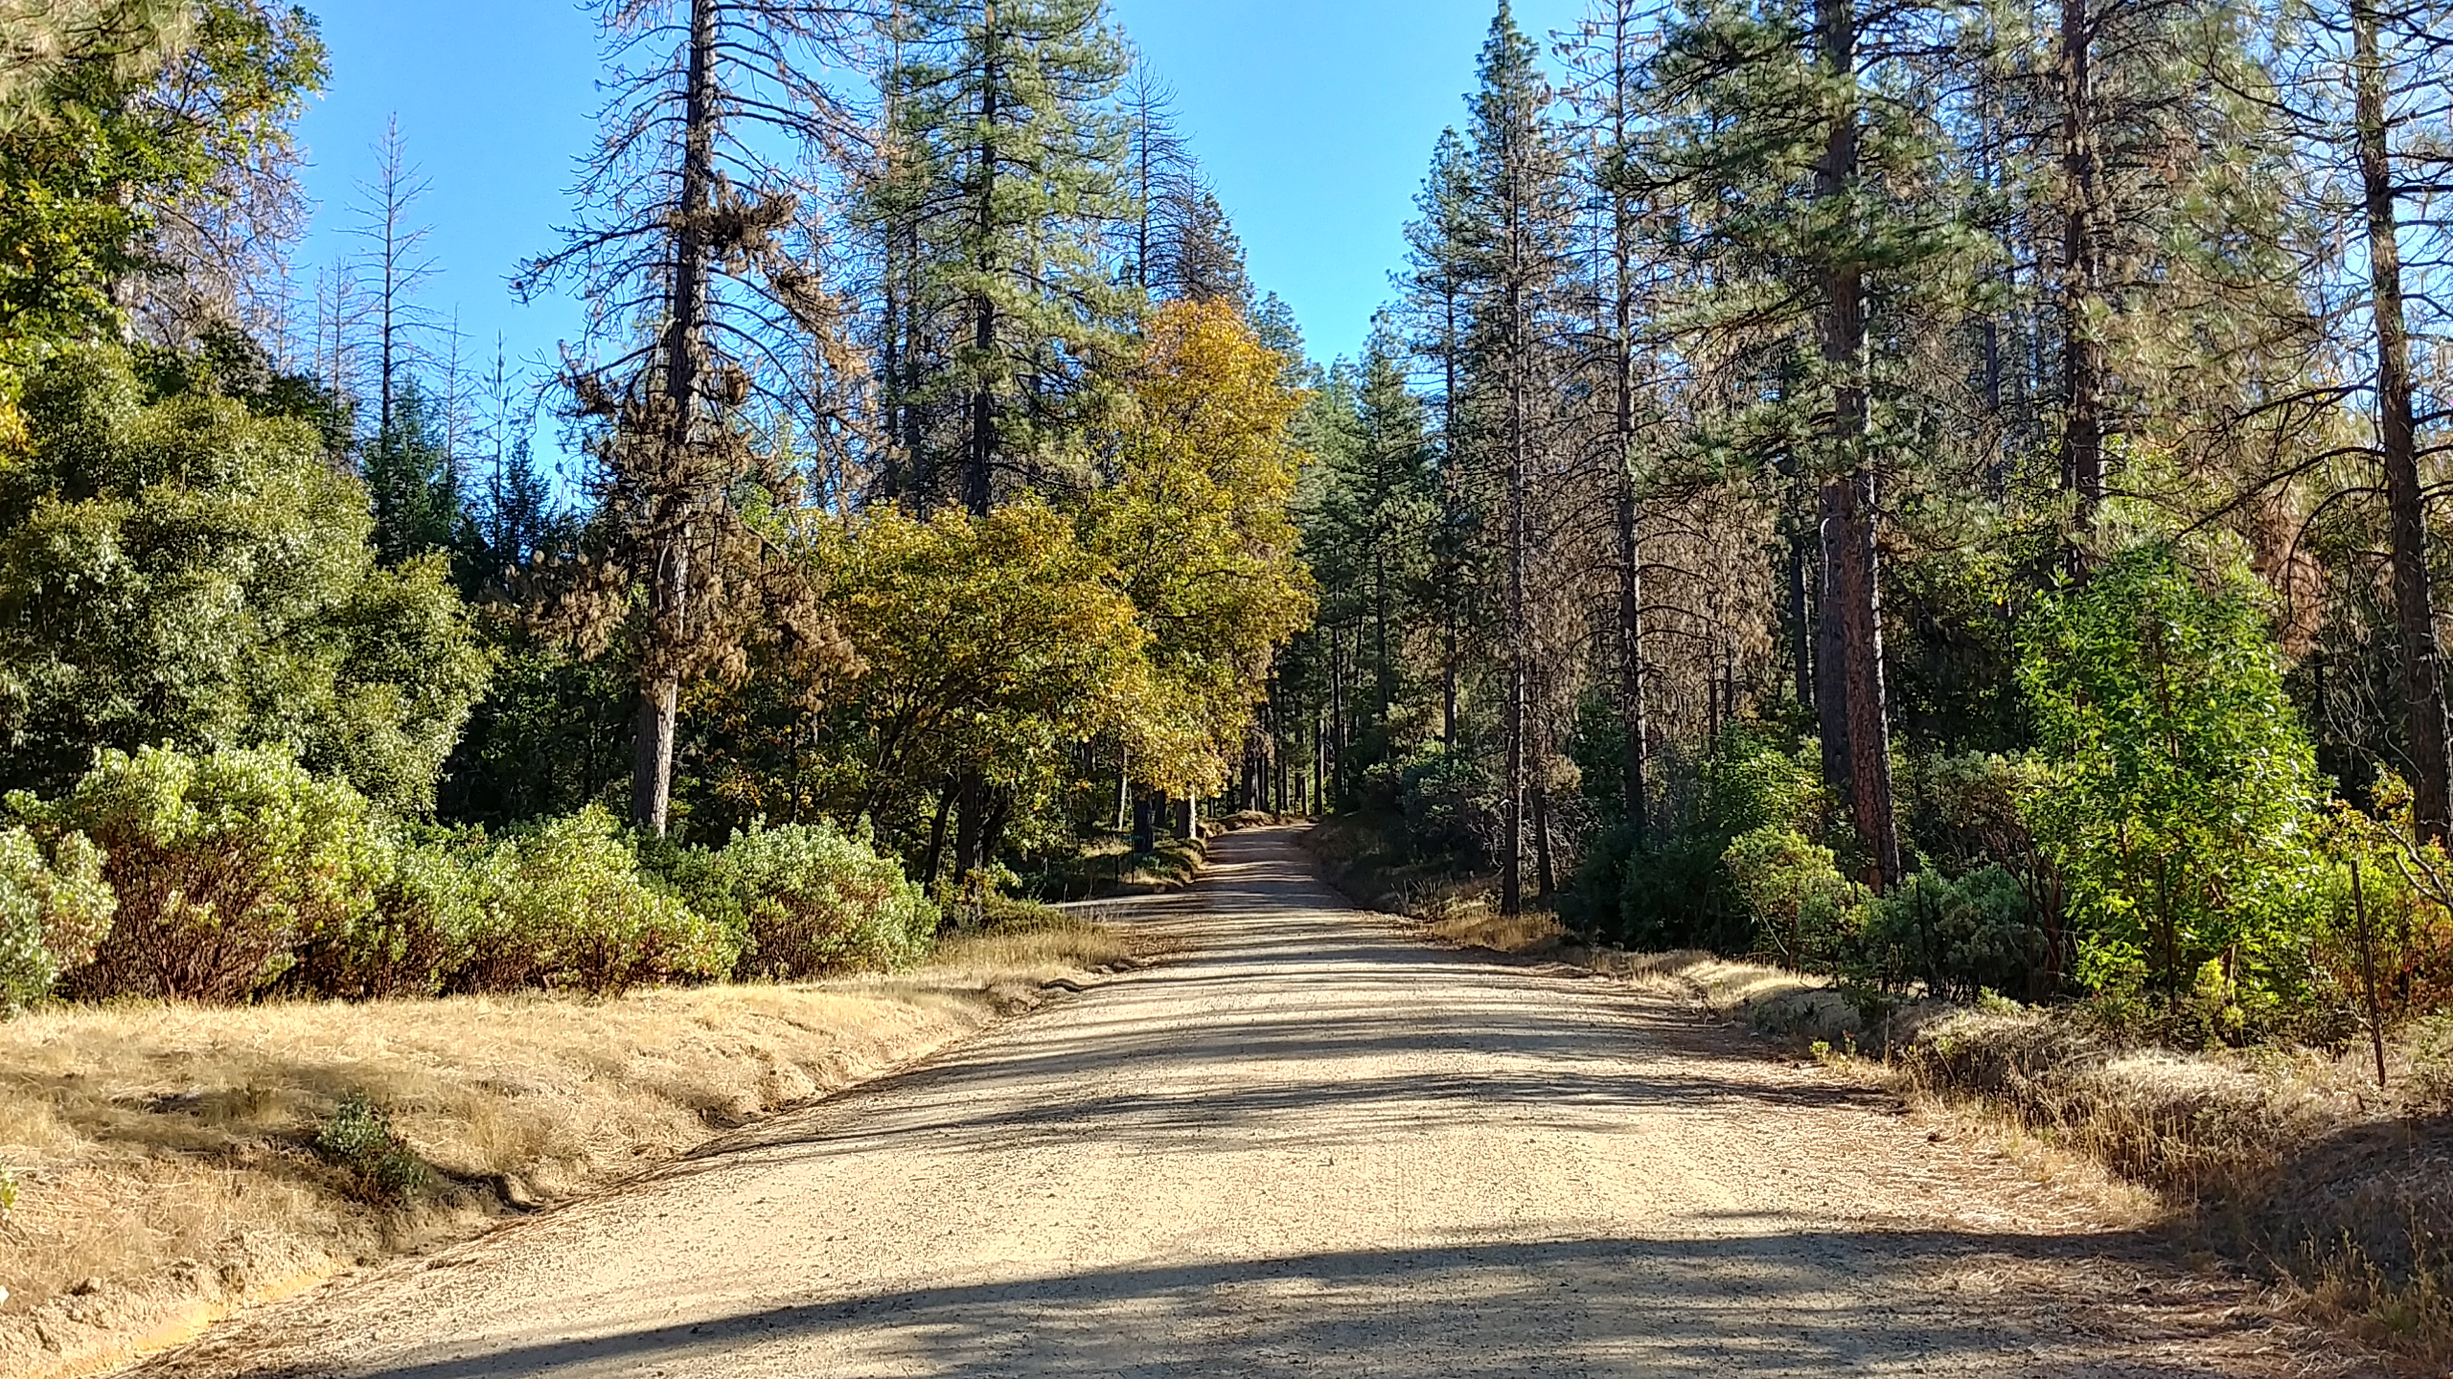
What does it look like or not?
Shrubs or bushes
Ladder from ground to tree crowns

Slide 10
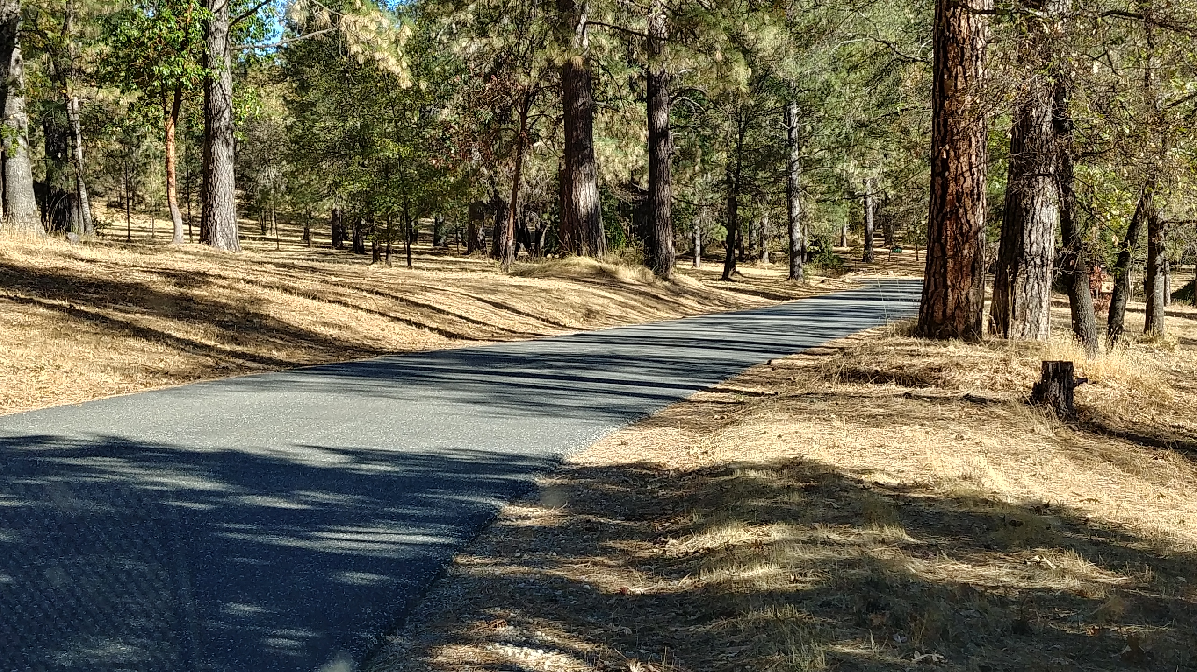
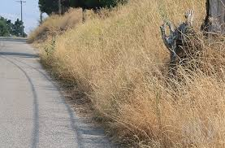
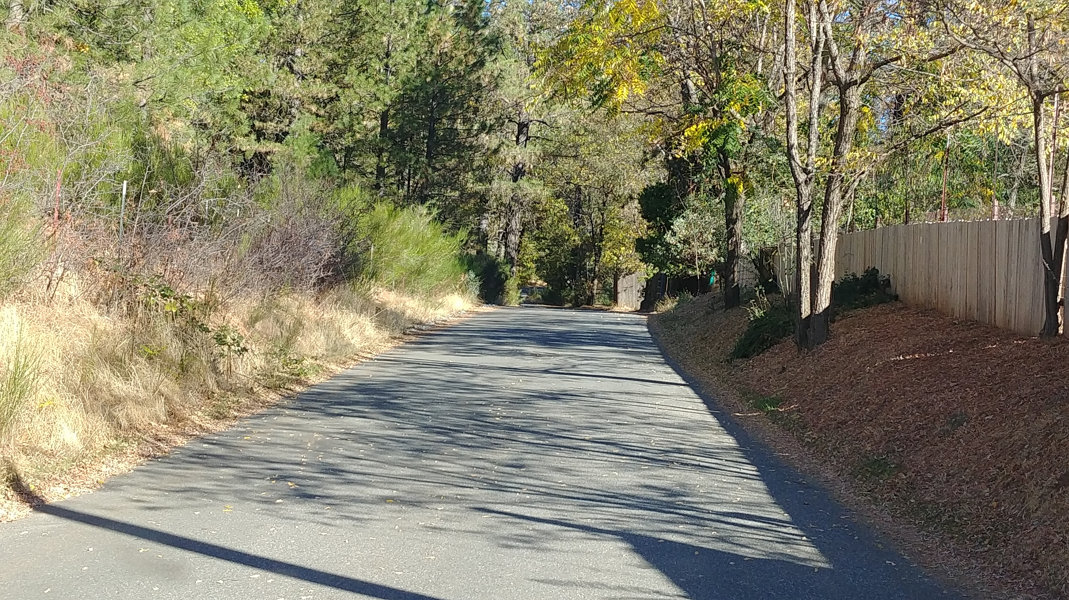
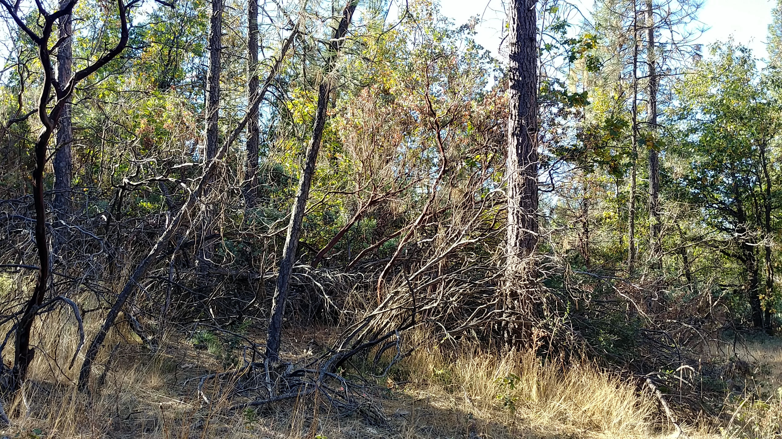
What does it look like or not?
Grass

Slide 11
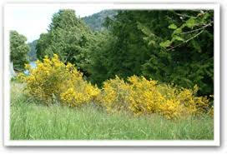
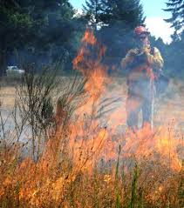
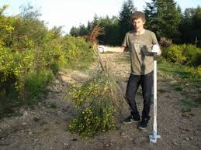
Why is Scotch broom so bad?
It burns very hot very fast!
It sprouts back and seeds last
Ways to get rid of for longer
  Pull
  Cover with black plastic
  Spray

Slide 12
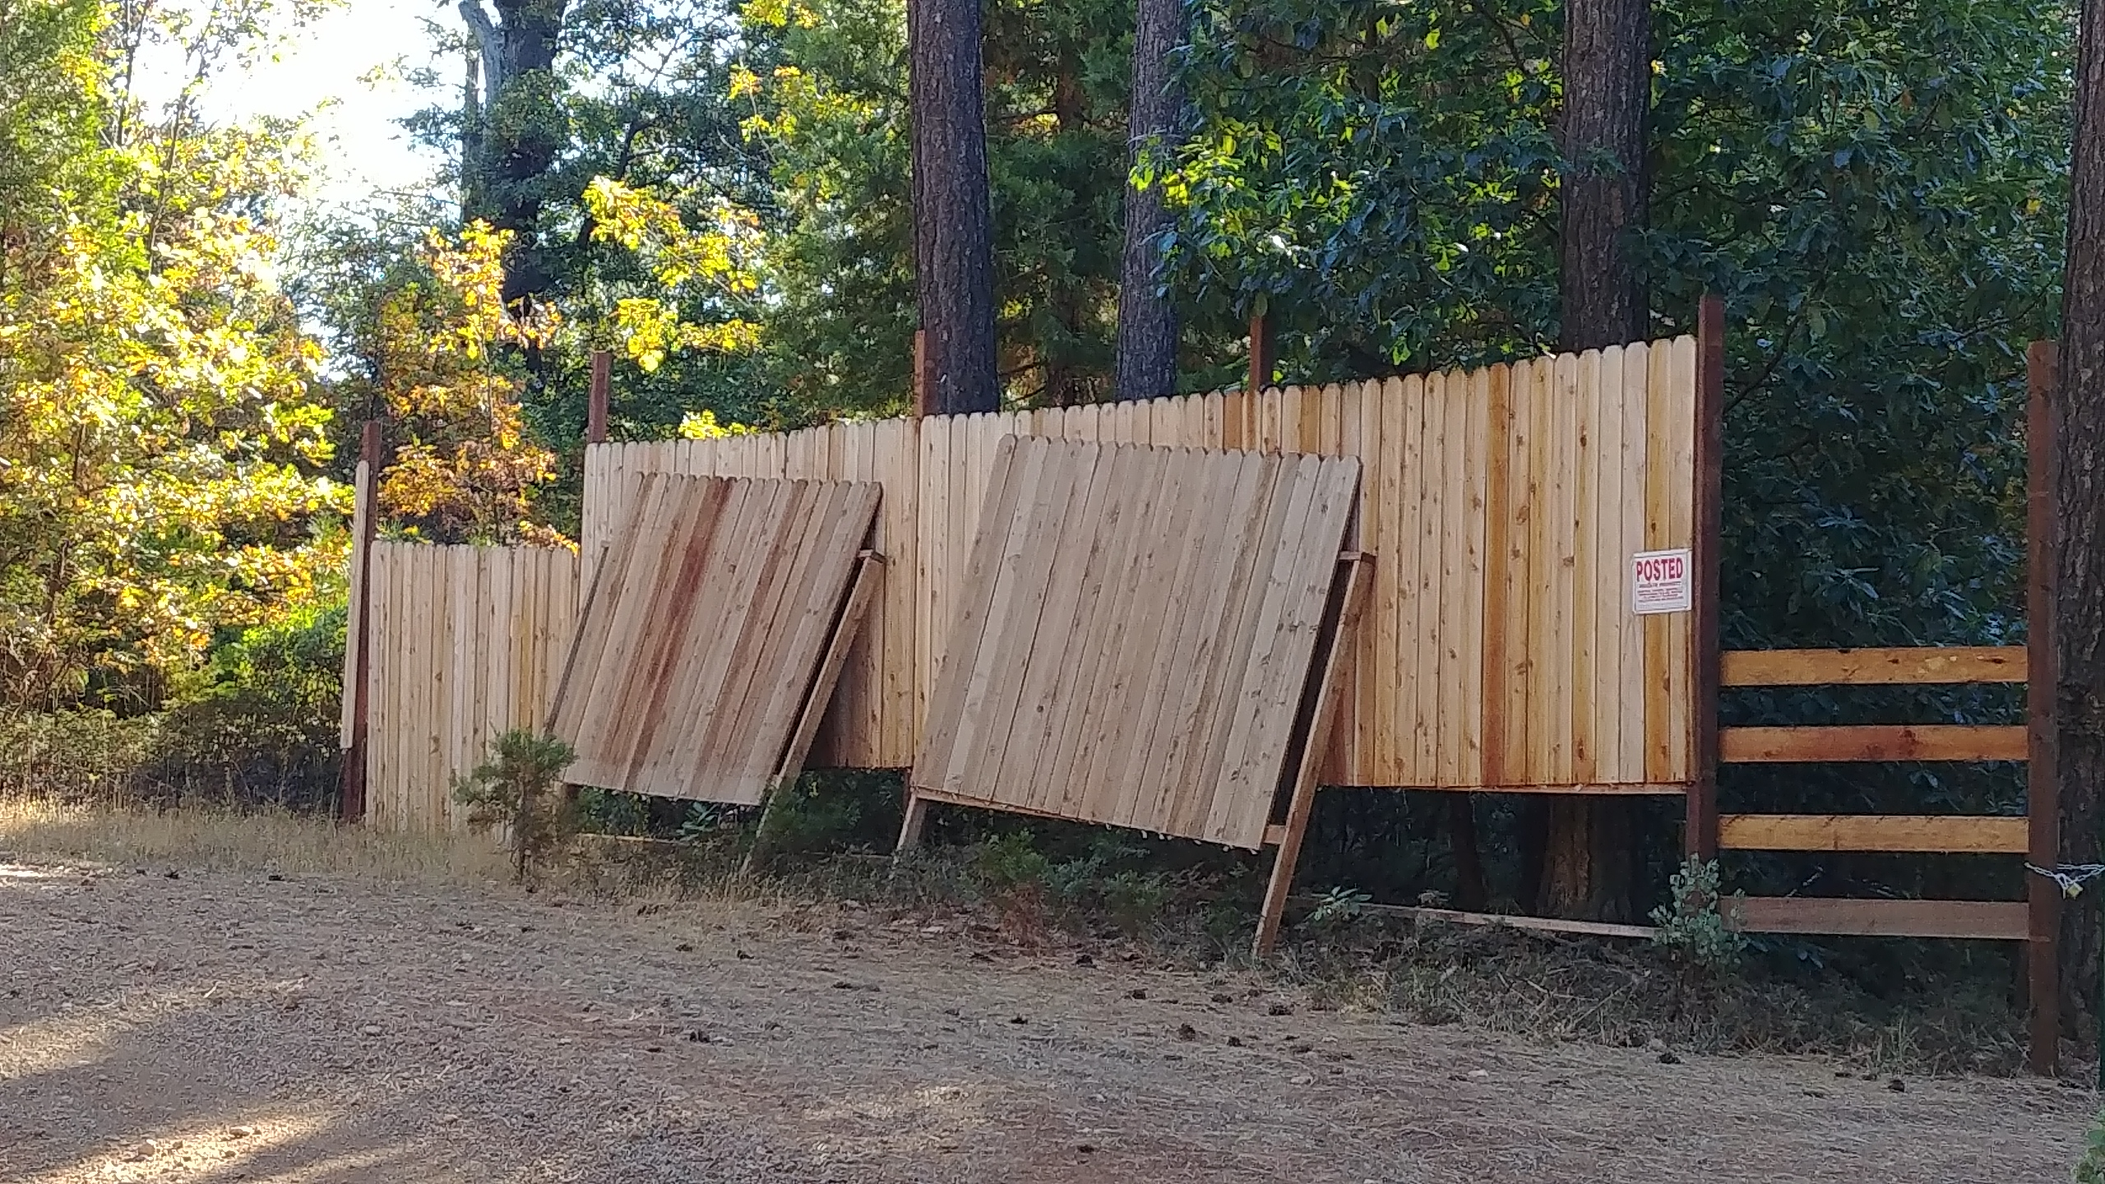
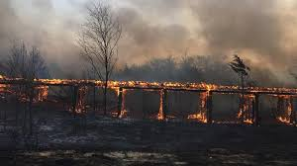
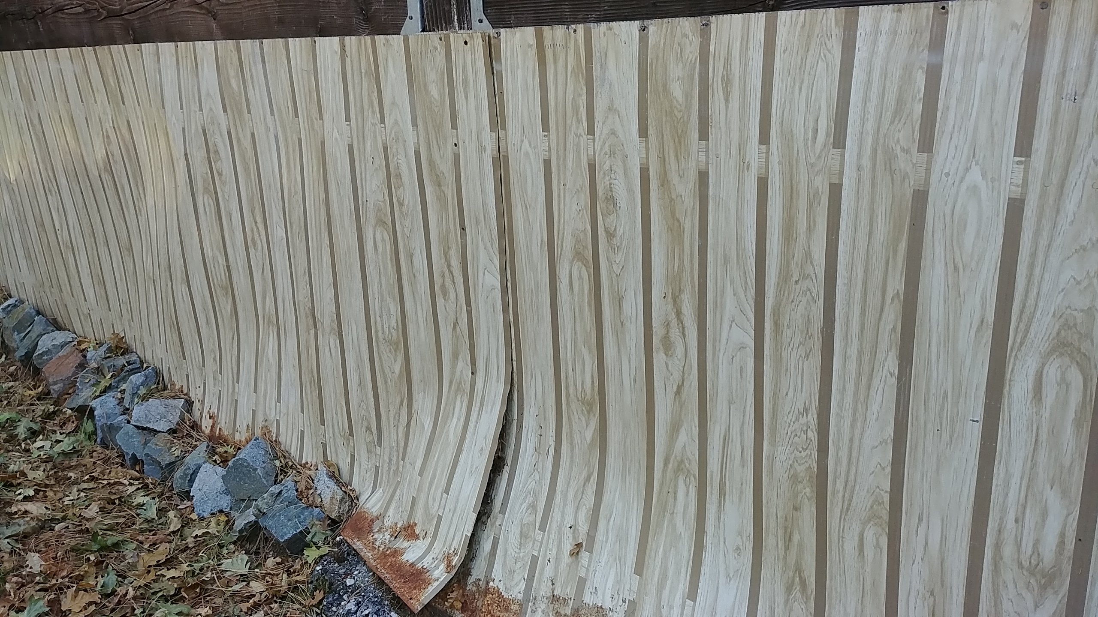
But I want my privacy!
Wood is pretty but burns well, close to a road is
very dangerous during a fire to you, neighbors evacuating and firefighters!
Cheap alternative
--Doughboy pool siding
available free all the time

Slide 13
How far to clear back?
Minimum 10 feet back and 15 feet up does not change fire in peak fire season
Better is County Hazard Abatement Ordinance
  75 feet or more
Use Defensible Space Guide for how much clearance
  Immediate ignition zone (0 to 30 feet)
  Outer area (30-100 feet or more)
  Larger properties (>100 feet)

Slide 14
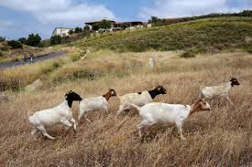
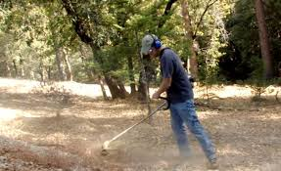
How to Get Work Done?
Depends on fuel type and road ownership
Grass
  Mow
  Weedwack
  Graze

Slide 15
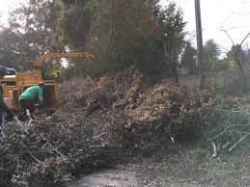
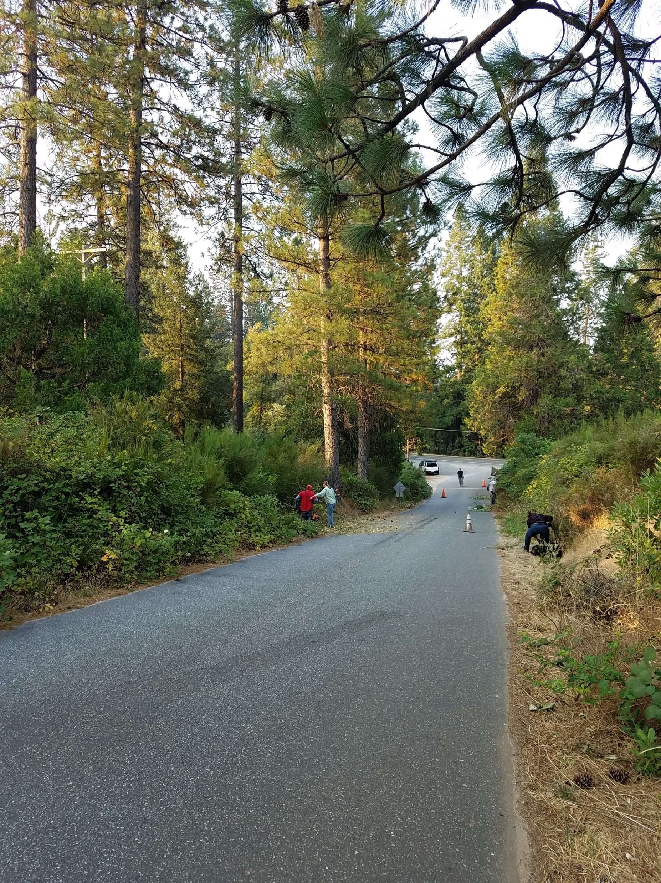
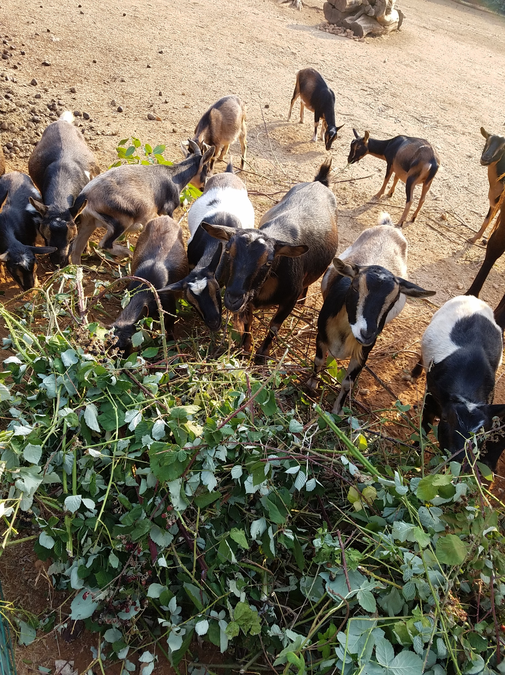
Shrubs and Vines (i.e. Blackberry)
  Sprouting (regrows)
    Pull –Scotch broom
    Graze
    Spray (if allowed and accepted)
    Repeat, repeat, repeat!
  Non-sprouting
    Cut and pile
    Chip or burn
    Haul to green waste dump site

Slide 16
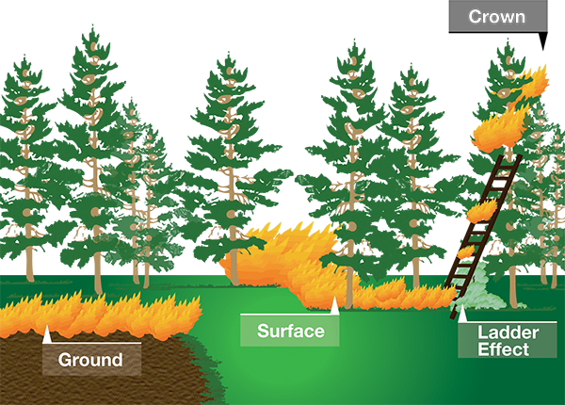
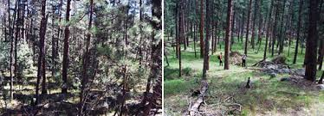
Forest/Trees
Limb up – not enough
Thin to wider spacing
  At least 12 feet between crowns
Use firewood
Pile and burn
Chip if not too much
Haul to green waste site
Trade logs for removal
Sell logs

Slide 17
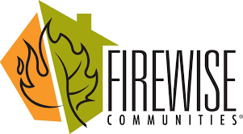
How to get the work done?
Neighborhood work parties
  If neighbors can’t do work, contribute to paying crew
  Make it short, bring food and drinks, prioritize
  Quarterly or monthly
  Start with a few people and talk to those driving by-educate
Firewise Communities priority for FSC grants/help
  Americorps Crew
  CALFIRE or other grants
  To qualify, demonstrate in-kind actions and money
EQIP grants from NRCS, larger parcels
Low income senior/disabled persons help from FSC
County Roads and Vacant Lots
  Organize permission from landowners to
  clear more than 10-15 foot minimum

Slide 18

Undeveloped Public Lands
Federal
  Bureau of Land Management (BLM),
  Tahoe National Forest (USFS),
State – State Parks
Local – NID, County, City
Contact them
  Let them know you are a Firewise Community
  You are concerned about fuels and are clearing surrounding private lands
  They often prioritize public lands in
  Wildland Urban Interface

Slide 19

Pieces
of the
Puzzle

Slide 20

Organizing Actions – WHEN?
Before and After Certification – Don’t wait!
  Record volunteer hours
  Record type of work and amount of fuels removed
  or chipped or burned
  Required for certification application
Continuously
  Defensible Space – before fire season (Now-May)
  Community Projects – several times a year
    Set dates community can plan around
    Be ready for requests from FSC for projects

